Slide 1
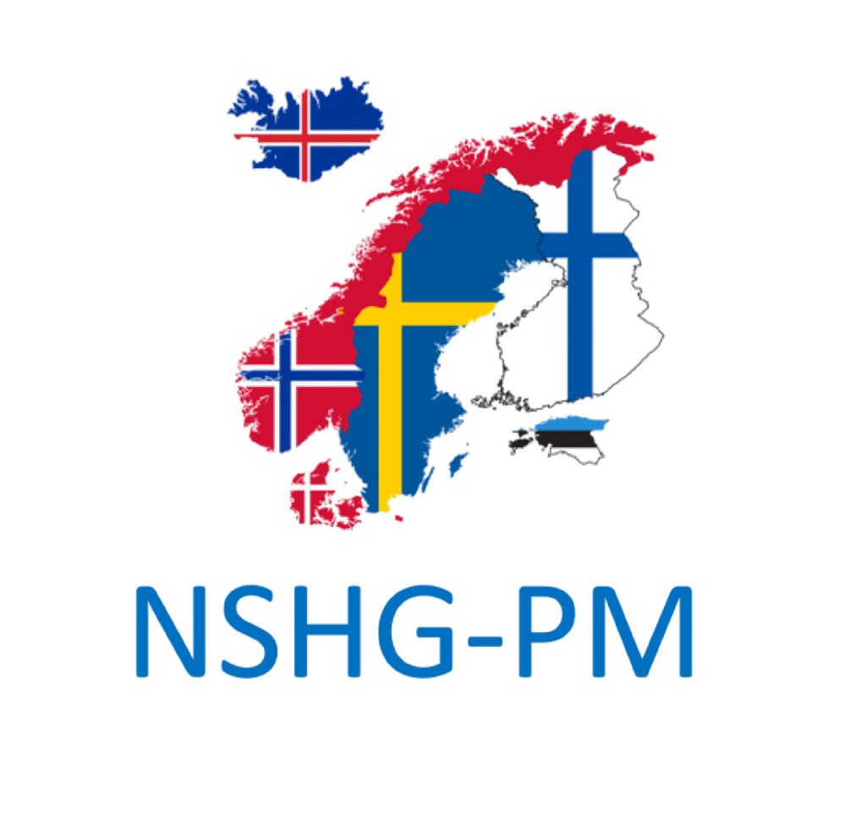
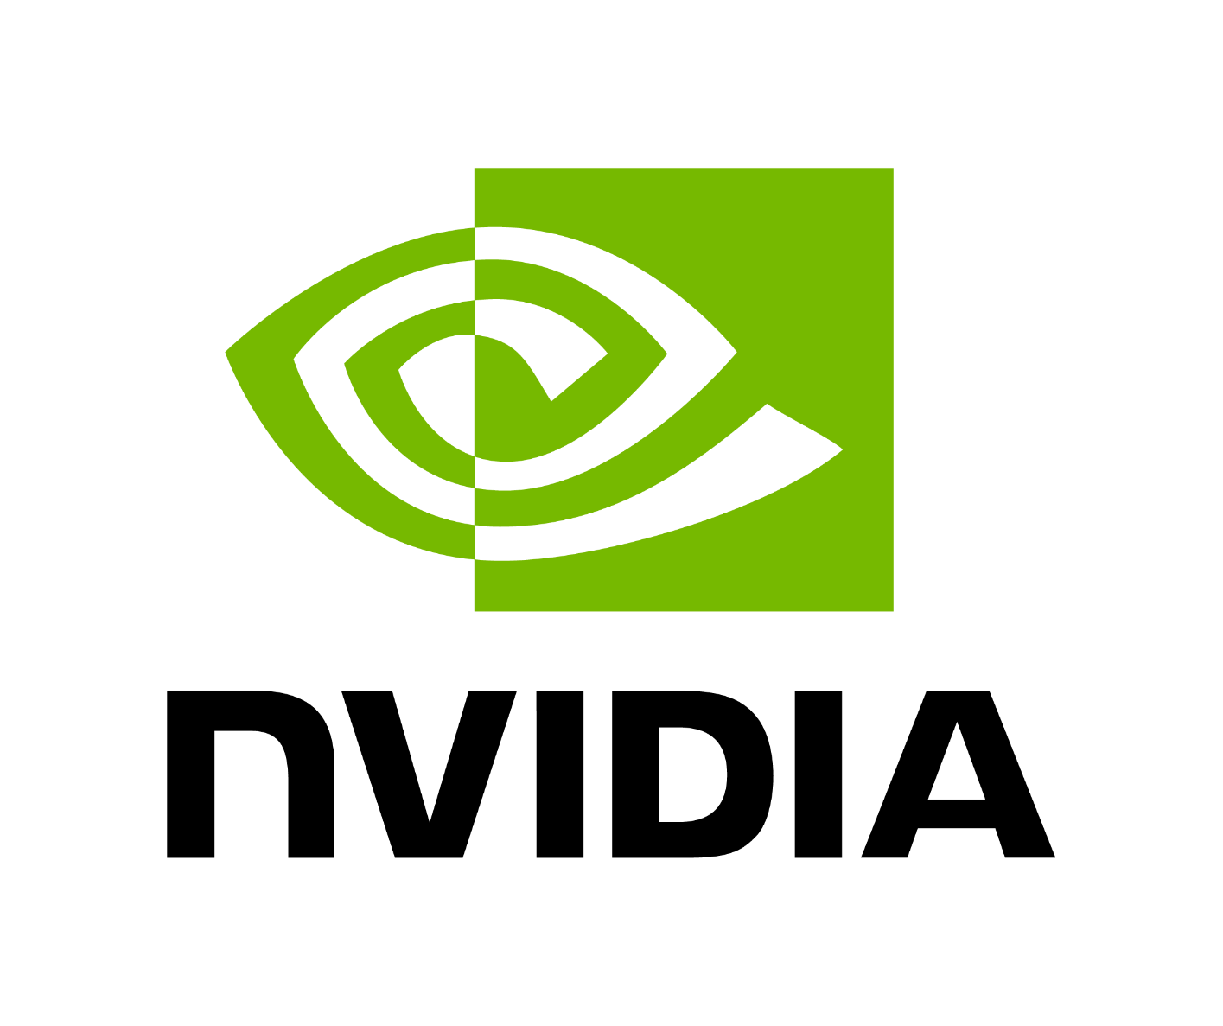

SuperFedMMD
Supercomputing-based Federated MultiModal Diagnostics
Team 6 - Aditya, Elise, Kalle, Thomas, Martin, Shambhavi

Slide 2
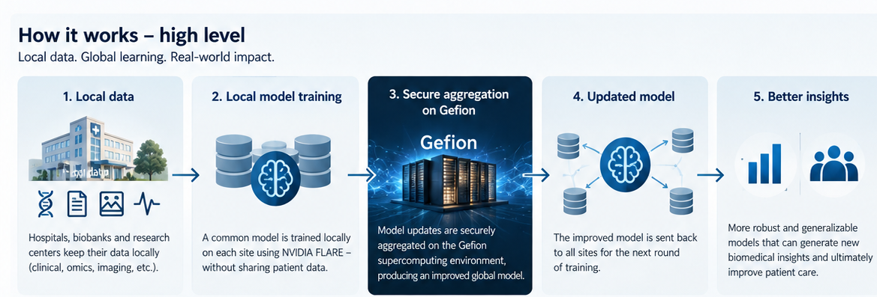

Slide 3

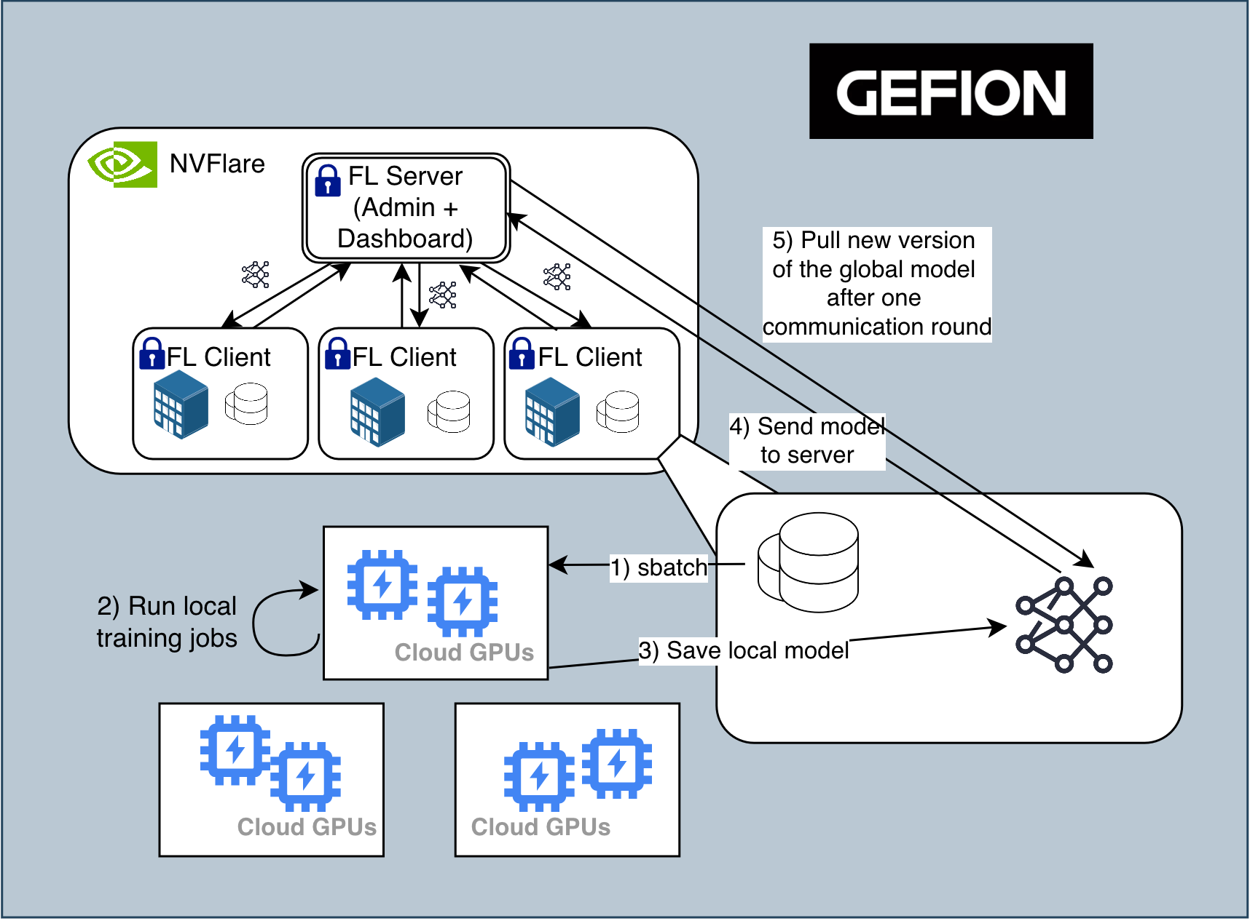

Slide 4
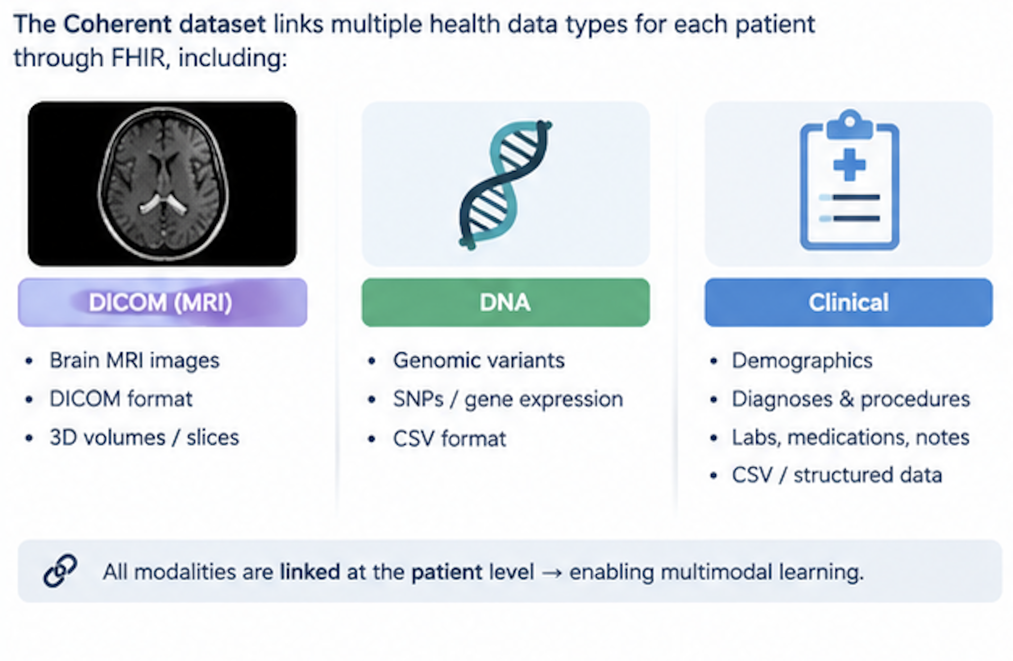
Coherence Dataset

Slide 5
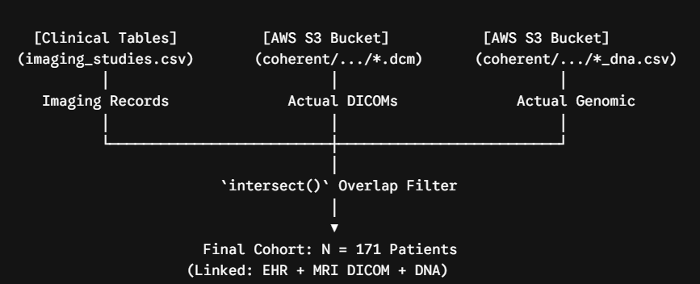
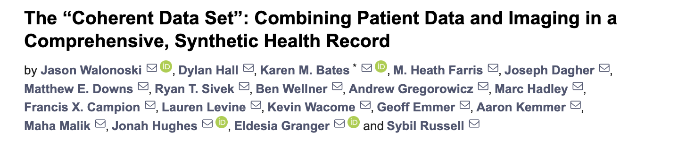
Our initial indexing script identified 171 patients with three-way multimodal overlap across EHR, DNA, and DICOM, closely aligning with the paper's reported benchmark of ~172.

Slide 6
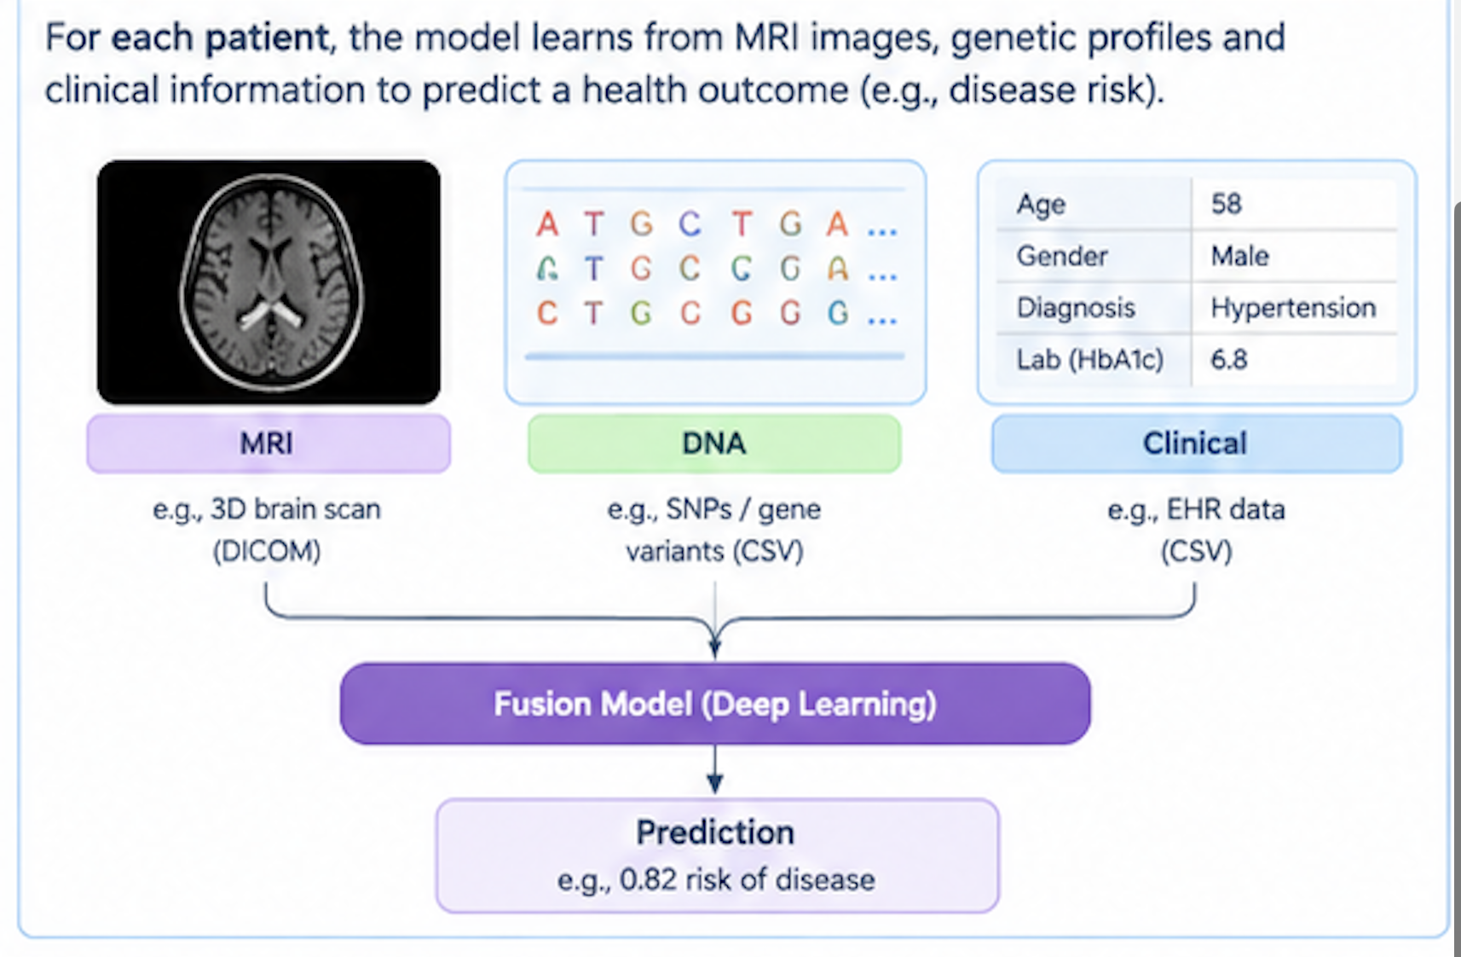
Fusion model
https://github.com/multimodal-healthcare/fusion

Slide 7
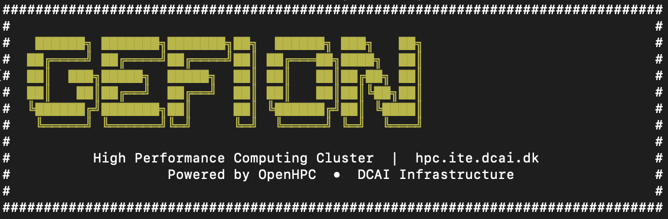
Our Outcomes
Multimodal training for DICOM, DNA and tabular data
Hyperparameter training
Slurm-based isolated* job orchestrations (not fully …. yet!)
CUDA-accelerated training of deep models in a federated manner
A simple federated pipeline with NVFlare for diverse data, simulating two biobanks
Leveraging sovereign supercomputing!

Slide 8
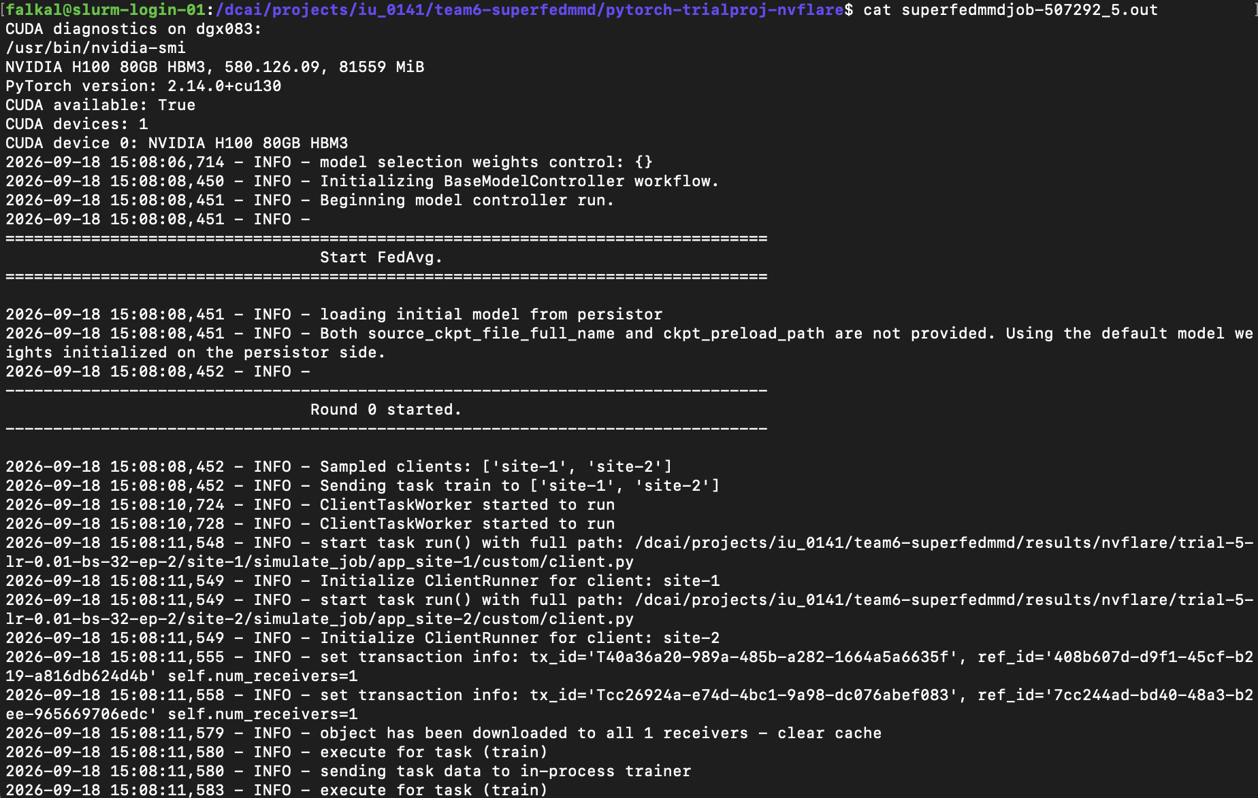
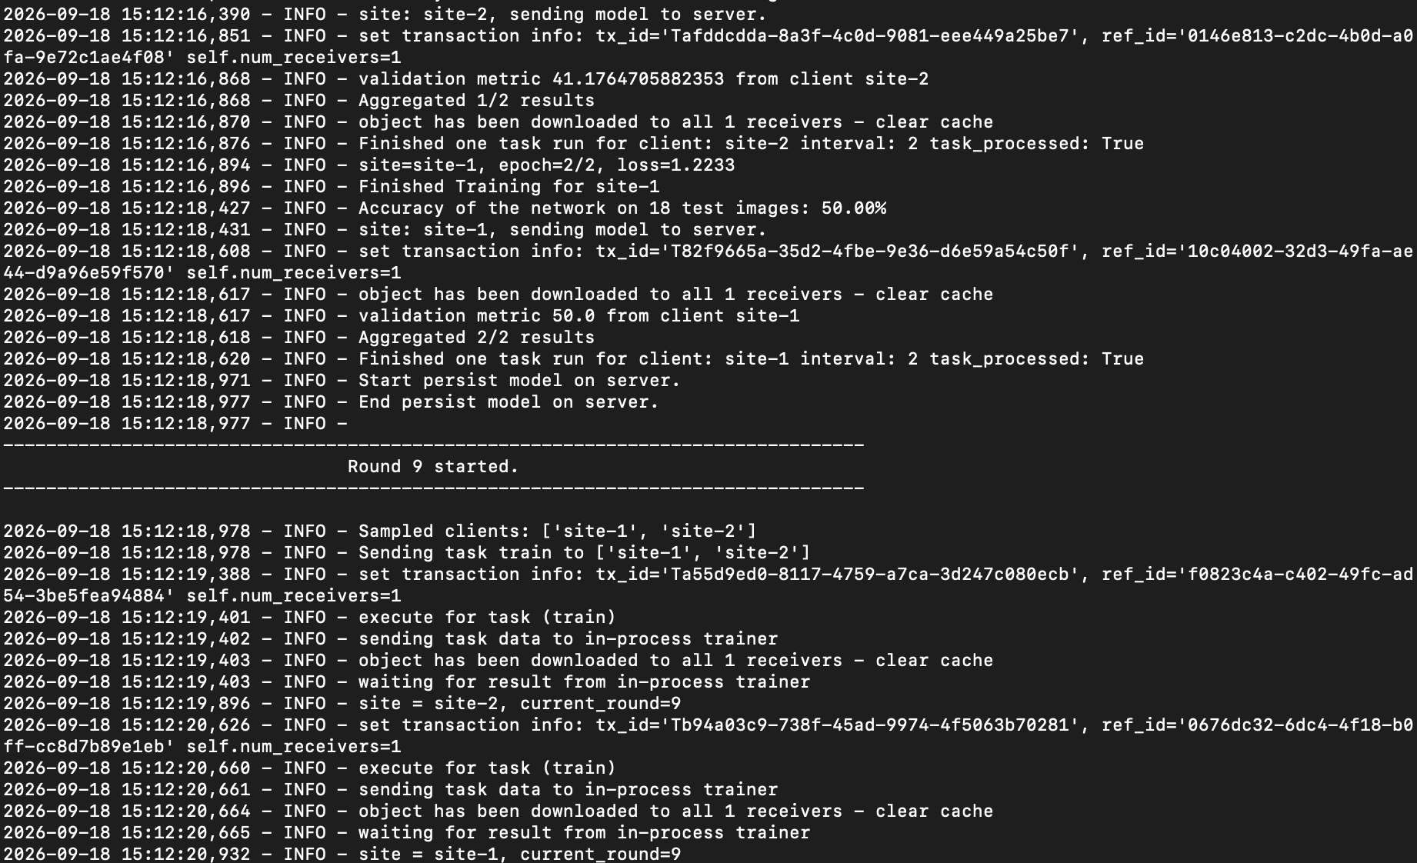
NVFlare for GPU-accelerated FL

Slide 10
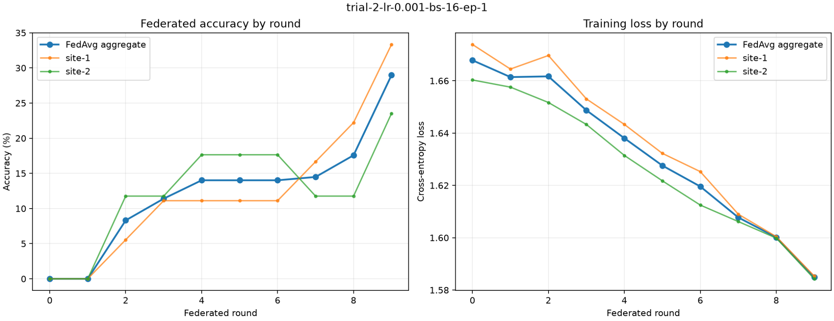
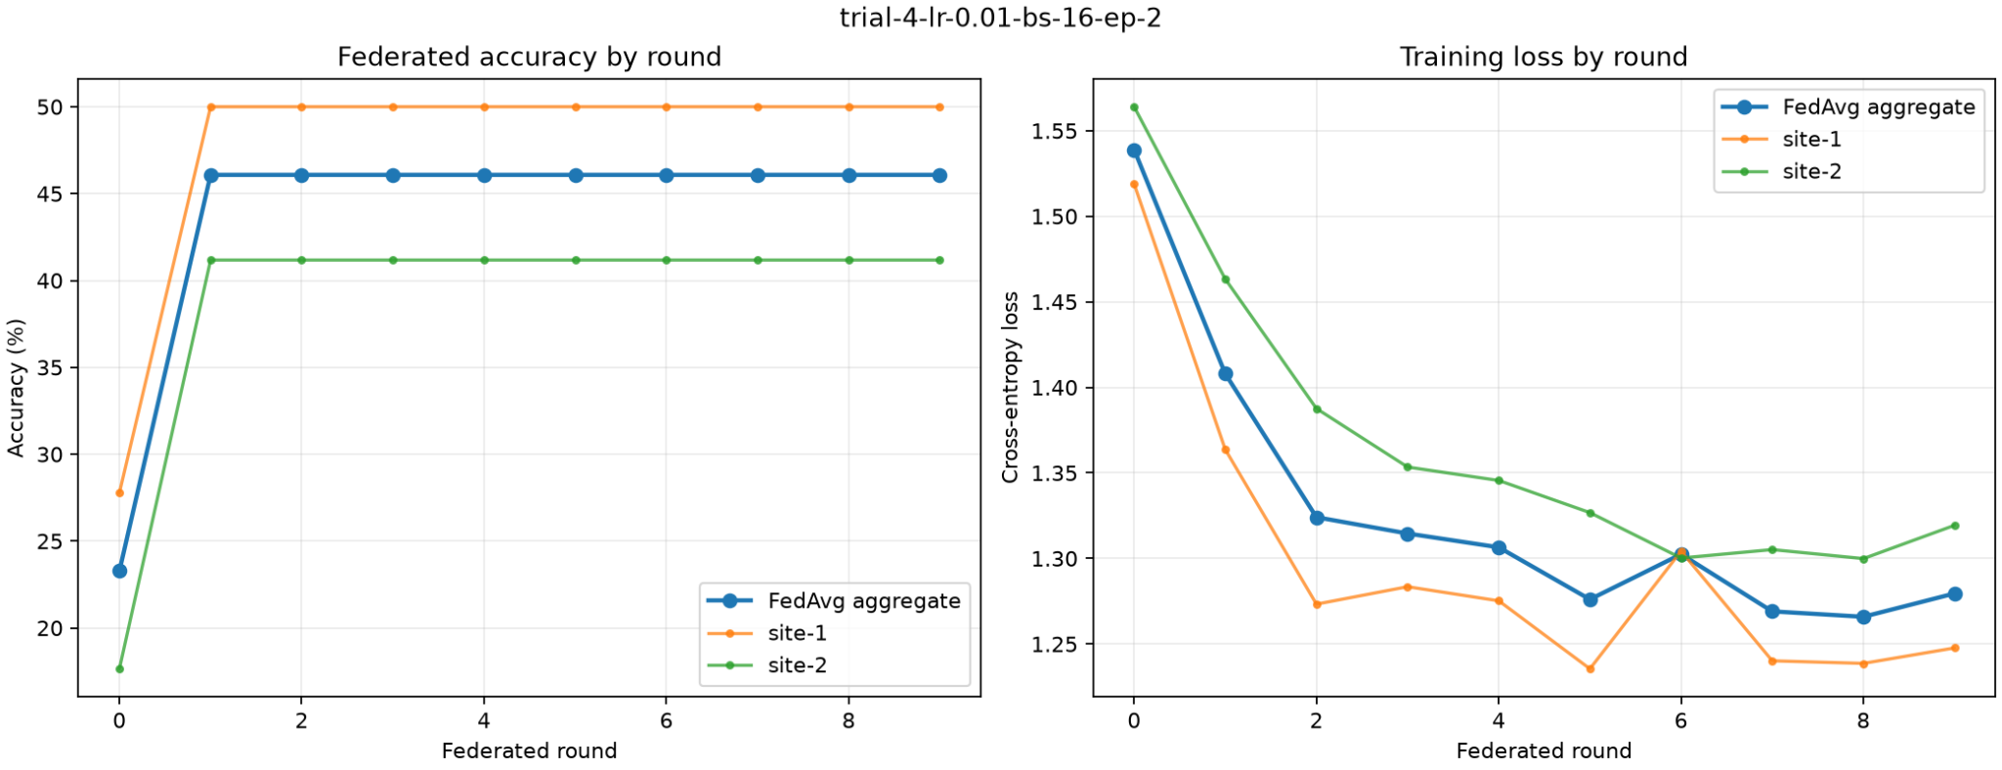

Slide 11
Limitations
In the Gefion proof of concept, the participating federation sites are logically separated workloads within a shared computing environment.
However …
They are not equivalent to independently administered institutional environments or security-isolated enclaves.
The experiment therefore demonstrates federated orchestration but does not by itself demonstrate protection against a privileged user with access to the shared environment.

Slide 12
Thank you!

